Slide 1

Data Analysis and Machine Learning: Transforming Data Into Insights
Unlocking actionable insights through advanced techniques
Nikhil Shah
Notes:
--- In this presentation, we will explore the critical role of data analysis and machine learning in deriving actionable insights from data. We will cover fundamental concepts, techniques, and applications that are transforming industries and decision-making processes.

Slide 2

Agenda for Data Analysis and Machine Learning
Introduction to Data Analysis
Fundamentals of Machine Learning
Data Preparation and Preprocessing
Exploratory Data Analysis (EDA)
Building and Training Machine Learning Models
Evaluating Model Performance
Applications and Use Cases
Notes:
We will begin with an introduction to data analysis, discussing its definition, importance, and various types of data. Next, we will delve into the fundamentals of machine learning, followed by data preparation and preprocessing techniques. We will explore exploratory data analysis, model building, evaluation, and finally, applications and future trends in machine learning.

Slide 3
Introduction to Data Analysis
Notes:
Data analysis is the systematic process of inspecting and interpreting data to extract meaningful insights. Understanding its significance is crucial for decision-making across various fields.

Slide 4

Definition and Importance of Data Analysis
Understanding Data Analysis
Data analysis is the process of organizing and interpreting data to find meaningful insights and trends. It helps businesses understand their performance and market dynamics.
Informed Decision-Making
Effective data analysis is crucial for making informed decisions that can impact business strategy and operations. It empowers leaders to base their decisions on solid evidence.
Driving Strategic Initiatives
Data analysis plays a vital role in driving strategic initiatives by identifying opportunities and risks, thus helping businesses to adapt and thrive in a competitive environment.
Notes:
Data analysis involves organizing, interpreting, and presenting data to uncover patterns and correlations. It is essential for making informed decisions and driving strategic initiatives in businesses.

Slide 5
Types of Data (Structured, Unstructured, Semi-Structured)
Structured Data
Structured data is highly organized, often stored in databases, and easily searchable using algorithms.
Unstructured Data
Unstructured data encompasses various formats like text documents, images, and videos, lacking a predefined structure.
Semi-Structured Data
Semi-structured data contains both organized elements and unstructured components, often utilizing tags for differentiation.
Notes:
Data can be classified into structured, unstructured, and semi-structured. Structured data is highly organized and easily searchable, while unstructured data includes formats like text and images. Semi-structured data contains tags or markers to separate data elements.

Slide 6

Common Data Analysis Techniques
Descriptive Statistics
Descriptive statistics summarize and describe the main features of a dataset, providing insights into its central tendency and variability.
Inferential Statistics
Inferential statistics allow analysts to make predictions or inferences about a population based on a sample of data.
Data Visualization
Data visualization techniques transform data into graphical formats, making complex data more accessible and understandable.
Notes:
Various techniques are employed in data analysis, including descriptive statistics, inferential statistics, and data visualization. These methods help analysts understand and present data effectively.

Slide 7
Fundamentals of Machine Learning
Notes:
Machine learning is a subset of artificial intelligence that uses algorithms to allow computers to learn from and make predictions based on data. Understanding its foundations is vital for effective application.

Slide 8

Overview of Machine Learning
Learning from Data
Machine learning allows systems to learn patterns and insights from data, improving their accuracy over time.
Model Creation
Creating models in machine learning involves training algorithms on input data to make accurate predictions or decisions.
Notes:
Machine learning enables systems to learn from data without being explicitly programmed. It involves creating models that can make predictions or decisions based on input data.

Slide 9

Types of Machine Learning (Supervised, Unsupervised, Reinforcement)
Supervised Learning
In supervised learning, models are trained using labeled data to make predictions or classifications based on input features.
Unsupervised Learning
Unsupervised learning algorithms analyze and identify patterns in unlabeled data, helping to uncover hidden structures.
Reinforcement Learning
Reinforcement learning involves agents learning optimal actions by interacting with their environment and receiving feedback.
Notes:
Machine learning is categorized into three types: supervised learning, where models are trained on labeled data; unsupervised learning, which identifies patterns in unlabeled data; and reinforcement learning, where agents learn by interacting with their environment.

Slide 10
Key Concepts and Terminology
Features in Machine Learning
Features are the individual measurable properties or characteristics used by machine learning algorithms to make predictions.
Labels and Outputs
Labels are the output variables that machine learning algorithms aim to predict, representing the desired outcome.
Training and Test Sets
Training sets are used to train algorithms while test sets are used to evaluate their performance and accuracy.
Notes:
Key concepts in machine learning include features, labels, training sets, and test sets. Understanding these terms is essential for grasping how machine learning algorithms operate.

Slide 11
Data Preparation and Preprocessing
Notes:
Data preparation is a crucial step in data analysis and machine learning, ensuring that the data is clean, structured, and ready for analysis.

Slide 12
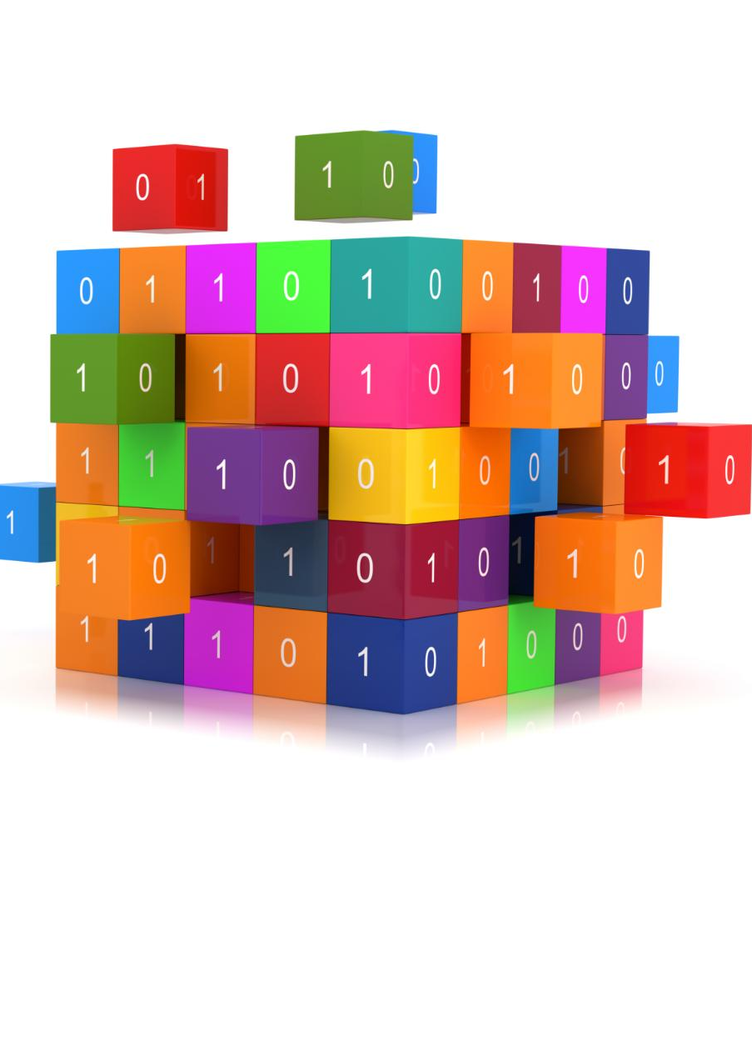
Data Cleaning and Handling Missing Values
Identifying Errors
The first step in data cleaning is identifying errors in the dataset. This ensures the dataset is reliable for analysis.
Handling Missing Values
Handling missing values is crucial for maintaining the quality of data. Techniques like imputation can effectively address these gaps.
Enhancing Data Quality
Data cleaning enhances the quality of data, making it more suitable for accurate analysis and decision-making.
Notes:
Data cleaning involves identifying and correcting errors in the dataset, including handling missing values through various imputation techniques, enhancing the quality of data for analysis.

Slide 13
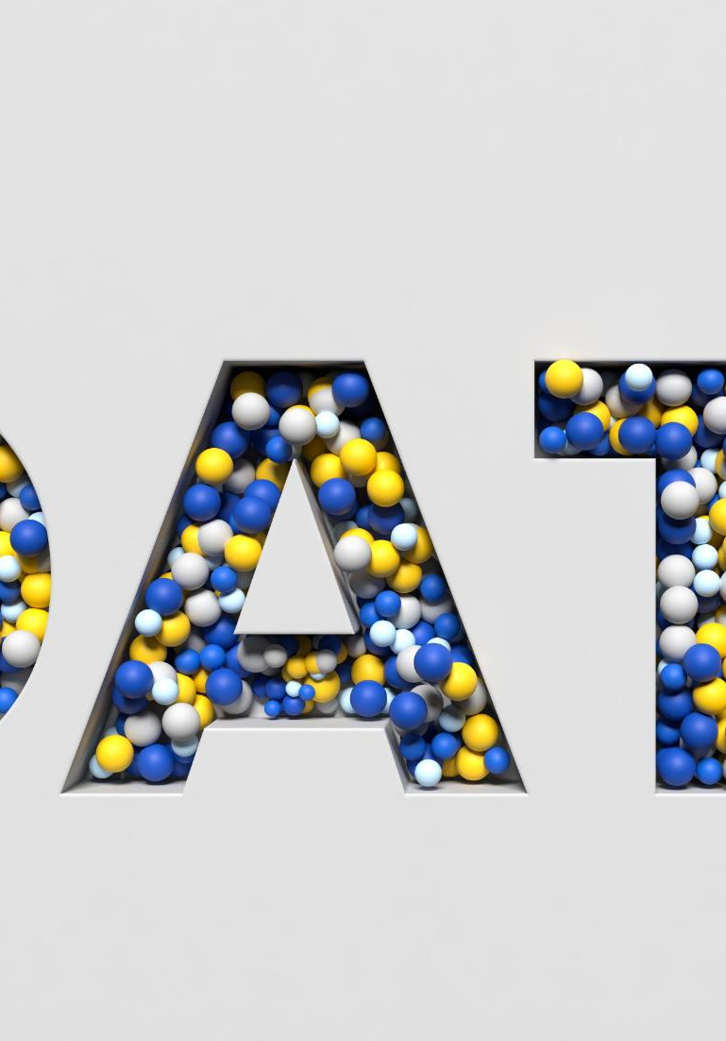
Feature Selection and Extraction
Relevance of Variables
Identifying relevant variables is crucial to enhance the performance of predictive models and minimize overfitting.
Model Performance Improvement
Effective feature selection helps in improving the overall performance of the model by reducing noise and irrelevant data.
Efficiency in Analysis
By reducing complexity through feature extraction, analysis becomes more efficient, saving time and resources.
Notes:
Feature selection and extraction involve identifying the most relevant variables from the dataset to improve model performance and reduce complexity, ensuring a more efficient analysis.

Slide 14

Data Normalization and Scaling
Purpose of Normalization
Normalization adjusts data values to a common scale, ensuring that no single feature dominates others during model training.
Importance of Scaling
Scaling improves convergence rates in machine learning algorithms by providing a consistent range for numerical features.
Techniques Used
Common techniques for normalization and scaling include min-max scaling and z-score standardization, each serving different purposes.
Notes:
Normalization and scaling are techniques used to adjust the range of data values, ensuring that numerical features contribute equally to model training and improving convergence rates.

Slide 15
Exploratory Data Analysis (EDA)
Notes:
Exploratory Data Analysis is a critical step in understanding the data's underlying structure. It involves visualizing data and identifying patterns that inform further analysis.

Slide 16

Techniques for Visualizing Data
Understanding Data Distributions
Histograms help visualize the distribution of data, showing how data points are spread across different ranges.
Analyzing Relationships
Scatter plots reveal correlations between two variables, helping to identify trends or patterns in data.
Summarizing Data
Box plots provide a concise summary of data, highlighting median, quartiles, and potential outliers.
Notes:
Data visualization techniques, such as histograms, scatter plots, and box plots, provide insights into data distributions and relationships, making it easier to communicate findings.

Slide 17

Identifying Patterns and Trends
Understanding Data Patterns
Exploratory Data Analysis (EDA) is essential for revealing underlying patterns in datasets, leading to insightful conclusions.
Formulating Hypotheses
Through EDA, analysts can form hypotheses based on observed trends, facilitating targeted research and analysis.
Guiding Further Analysis
Identifying trends directs the course of further analysis and modeling efforts, ensuring a focused approach.
Notes:
EDA helps identify patterns and trends in data, enabling analysts to form hypotheses and guiding the direction of further analysis and modeling efforts.

Slide 18

Hypothesis Testing and Statistical Analysis
Understanding Hypothesis Testing
Hypothesis testing allows researchers to draw conclusions about populations using data from samples, providing insights into larger trends.
Role of Statistical Analysis
Statistical analysis techniques are essential for validating or refuting assumptions, enabling informed decision-making in various fields.
Guiding Decision-Making
Effective statistical analysis guides decision-making processes by providing evidence-based insights and reducing uncertainties.
Notes:
Hypothesis testing is used to make inferences about populations based on sample data. Statistical analysis techniques help validate or refute assumptions and guide decision-making.

Slide 19
Building and Training Machine Learning Models
Notes:
Building and training machine learning models involves selecting suitable algorithms and tuning parameters to ensure models perform effectively on unseen data.

Slide 20

Choosing the Right Algorithm
Importance of Algorithm Selection
Choosing the right algorithm directly influences the success of your model in achieving accurate results.
Data Characteristics
Understanding the characteristics of your data is essential for selecting an effective algorithm tailored to your needs.
Problem Type Consideration
Different problem types, such as classification or regression, require distinct algorithms to solve effectively.
Desired Output
Identifying the desired output is crucial as it guides the selection of the most suitable algorithm for your task.
Notes:
Selecting the appropriate algorithm is crucial for model success. Factors to consider include data characteristics, problem type, and the desired output.

Slide 21

Model Training and Validation
Model Training Process
Model training involves inputting data into algorithms to learn underlying patterns and relationships within the data.
Importance of Validation
Validation is crucial for assessing the model's performance on a separate dataset, ensuring its ability to generalize to new data.
Generalization of Models
Proper training and validation ensure models can generalize effectively, making accurate predictions on unseen data.
Notes:
Model training involves feeding data into the algorithm to learn patterns, while validation assesses model performance on a separate dataset, ensuring generalization.

Slide 22

Hyperparameter Tuning and Optimization
Understanding Hyperparameters
Hyperparameters are settings that govern the training process but are not updated during training.
Importance of Tuning
Proper tuning of hyperparameters can lead to significant improvements in model accuracy and efficiency.
Optimization Techniques
Various techniques exist for hyperparameter optimization, including grid search, random search, and Bayesian optimization.
Notes:
Hyperparameter tuning refers to the optimization of model parameters that are not learned during training. Proper tuning can significantly enhance model performance.

Slide 23
Evaluating Model Performance
Notes:
Evaluating model performance is essential to ensure that the model performs well on new, unseen data. Various metrics and techniques are employed in this process.

Slide 24

Metrics for Classification and Regression
Metrics for Classification
Common metrics for evaluating classification models include accuracy, precision, and recall. These metrics help assess the model's effectiveness.
Metrics for Regression
In regression analysis, metrics like mean squared error and R-squared are crucial for assessing model performance.
Importance of Metrics
Choosing the right metric is essential as it directly impacts the evaluation of model performance for specific tasks.
Notes:
Different metrics are used to assess model performance based on the problem type. For classification tasks, accuracy, precision, and recall are common metrics. For regression, we often use mean squared error and R-squared.

Slide 25

Cross-Validation Techniques
Importance of Cross-Validation
Cross-validation techniques are crucial in understanding how well a machine learning model performs on unseen data.
K-Fold Cross-Validation
K-fold cross-validation is a popular method that divides the dataset into K subsets, ensuring a reliable performance estimate.
Notes:
Cross-validation techniques help assess how a model will generalize to an independent dataset. K-fold cross-validation is a widely used method that provides more reliable performance estimates.

Slide 26

Handling Overfitting and Underfitting
Understanding Overfitting
Overfitting occurs when a model learns noise instead of the signal, resulting in poor generalization to new data.
Understanding Underfitting
Underfitting happens when a model is too simple to capture the underlying patterns in the data, leading to high bias.
Mitigation Techniques
Regularization, pruning, and selecting simpler models are effective techniques to manage overfitting and underfitting.
Notes:
Managing overfitting and underfitting is crucial for model robustness. Techniques such as regularization, pruning, and choosing simpler models can help mitigate these issues.

Slide 27
Applications and Use Cases
Notes:
Machine learning has diverse applications across various industries. Understanding these use cases can inspire innovative solutions and improvements.

Slide 28
Machine Learning in Business and Finance
Predictive Analytics
Machine learning algorithms are utilized to analyze data and make predictions, helping businesses make informed decisions.
Fraud Detection
Machine learning enhances security by identifying fraudulent activities through anomaly detection in transactions.
Customer Segmentation
Machine learning enables businesses to segment customers effectively, improving marketing strategies and customer engagement.
Notes:
In business and finance, machine learning enhances decision-making through predictive analytics, fraud detection, and customer segmentation, driving efficiency and profitability.

Slide 29
Applications in Healthcare and Medicine
Improved Diagnostics
Machine learning algorithms analyze medical data to enhance the accuracy of diagnostics in various medical fields.
Personalized Treatment Plans
Machine learning enables the creation of personalized treatment plans based on individual patient data and historical outcomes.
Predicting Patient Outcomes
By analyzing data, machine learning helps predict patient outcomes, improving the decision-making process for healthcare providers.
Notes:
Machine learning is revolutionizing healthcare by improving diagnostics, personalizing treatment plans, and predicting patient outcomes, ultimately enhancing patient care.

Slide 30

Future Trends and Emerging Applications
Advancements in AI
The field of artificial intelligence is rapidly evolving, leading to smarter systems and enhanced decision-making capabilities across multiple sectors.
Automated Systems
Automation is set to revolutionize industries by increasing efficiency and reducing human intervention in routine tasks.
New Applications
Emerging applications of machine learning are expected to create transformative innovations in healthcare, finance, and transportation.
Notes:
The future of machine learning promises advancements in artificial intelligence, automated systems, and new applications in various sectors, paving the way for transformative innovations.

Slide 31
Conclusion
Power of Data Analysis
Data analysis enables organizations to convert raw data into actionable insights that drive decision-making processes.
Machine Learning Techniques
Machine learning techniques allow organizations to automate insights generation and improve operational efficiency.
Informed Decision Making
Leveraging these tools helps organizations make informed decisions that drive growth and competitiveness.
Notes:
Data analysis and machine learning are powerful tools that can transform raw data into meaningful insights. By leveraging these techniques, organizations can make informed decisions, drive growth, and stay competitive in an increasingly data-driven world.

